Slide 1
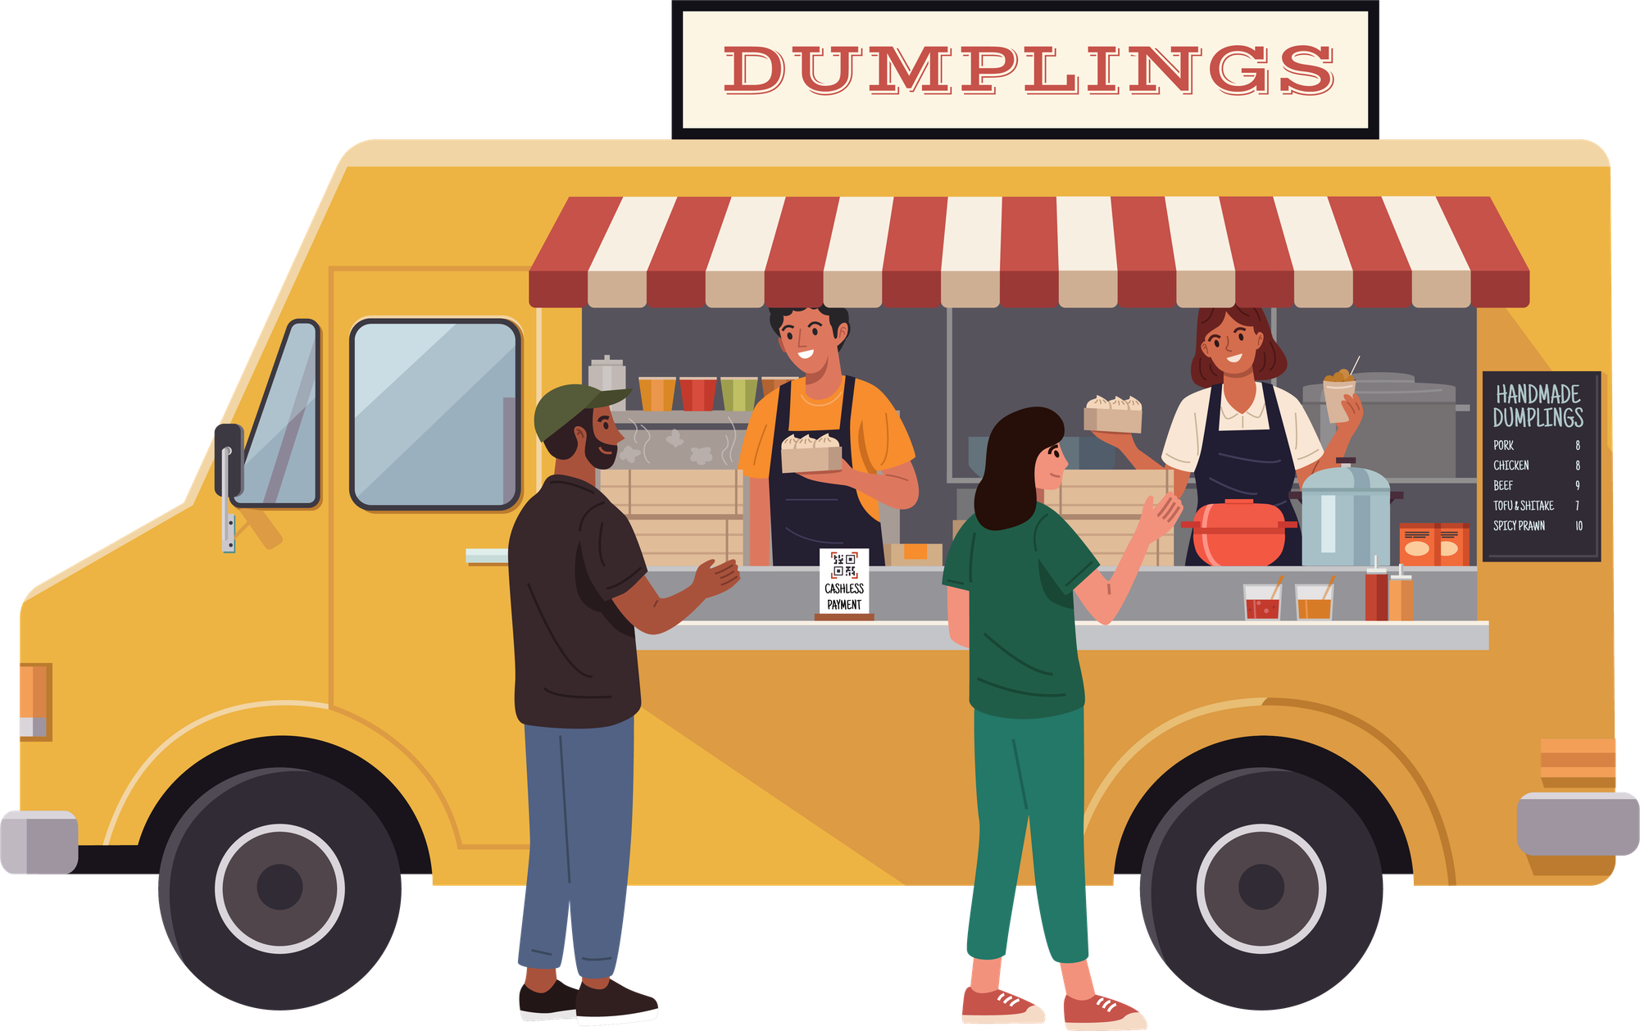
Dalla3 Kershak University Food Application
University Food Ordering Platform
Modernizing the Campus Dining Experience
Dr: Ahmed Mahran
Code: AHU20XX
Prepared by: Team Masterpiece

Slide 2
1. The Problem
University students usually have only 10–15 minutes between lectures.
During this short break, they face:
  Long queues at cafeterias
  Overcrowded food areas
  Wrong orders due to pressure
  Wasting time waiting
  Missing meals
  Being late for lectures
Real Story:
Many students spend their entire break waiting in line, then either skip food or arrive late to class.

Slide 3
2. The Solution
A smart platform that connects all university cafeterias in one place.
How It Works:
  Student opens the app during lecture
  Selects restaurant and items
  Pays online
  Chooses pickup time
  Receives notification when ready
  Picks up food instantly with no queue
Key Features:
  Online ordering
  Scheduled pickup
  Real-time notifications
  Digital wallet
  Loyalty rewards
  Vendor dashboard

Slide 4
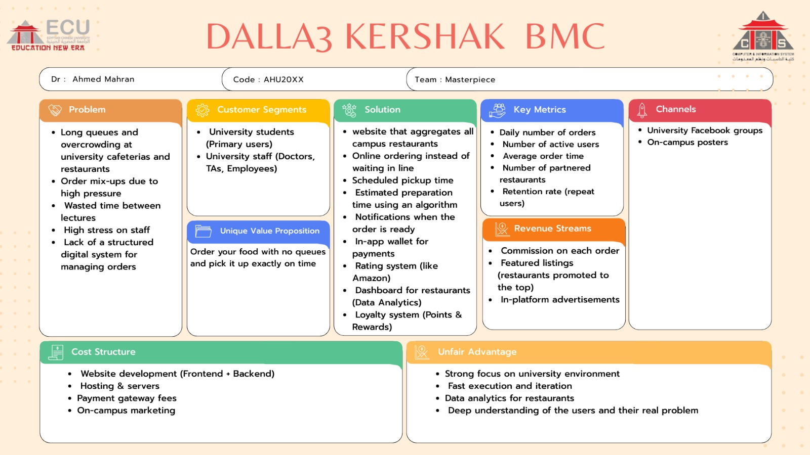
3. Business Model Canvas

Slide 5
4. Market & Competitors
Market Opportunity
Thousands of students buy food daily inside universities.
If only 500 students order daily:
500 × 5 EGP = 2,500 EGP/day
Competitors:
Direct competitors inside campus: None
Indirect competitors:
  Traditional queues
  Direct cafeteria buying
  Delivery apps
Our Advantage:
  First mover in university market
  Faster than delivery apps
  Designed specifically for students

Slide 6
5. Timeline
Week 2: Backend Development
Week 1: Architecture & Database
Objective: Build the foundation
Tasks:
• Choose database
• Design schemas
• Setup server
• Configure security
Objective: Build core system
Tasks:
• Authentication system
• Restaurant APIs
• Order system
• Queue system
• Wallet system
Week 3: Integration
Week 4: Testing & Optimization
Objective: Connect frontend and backend
Tasks:
• Connect React with APIs
• Implement order tracking
• Connect restaurant dashboard
• Manage application state
Objective: Ensure system quality
Tasks:
• Full system testing
• Load testing
• Fix bugs
• Final deployment

Slide 7
6. What We Need Now
We are asking for:
  Approval to continue development
  Access to pilot test inside university
  Partnerships with cafeterias
  Feedback from mentors
  Support for launch phase
Our Goal:
To become the official smart food ordering platform for universities.

Slide 8


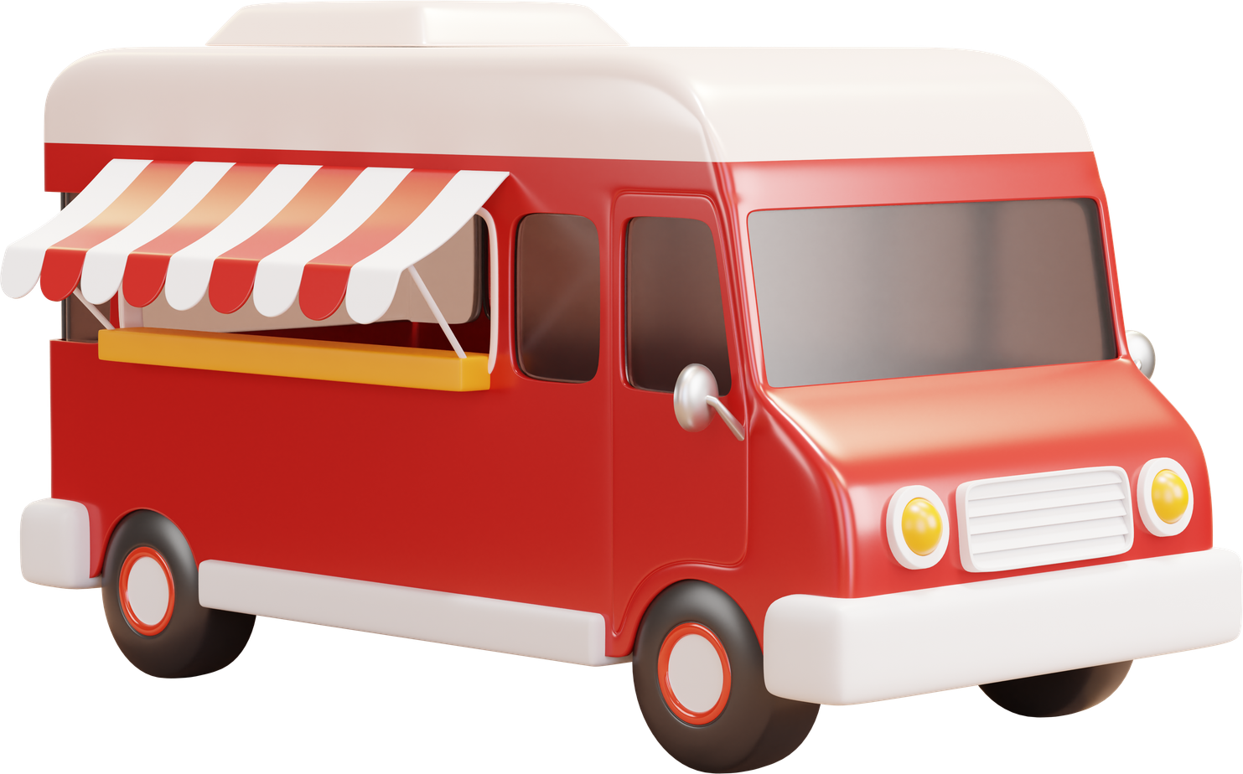

THANK YOU
We would like to sincerely thank Dr. Soha Safwat and Dr. Ahmed Mahran for their valuable support and great efforts throughout our project.
Your guidance and encouragement meant a lot to us and truly made a significant difference.
OUR TEAM:
Ebrahim Yussif Ebrahim | C4 | 692400174 | Ahmed Mohamed Refaat | C2 | 692400154
Fady Fouad Milad | C3 | 692400508 | Noura Maher Mohamed | C3 | 692400276
Ferial Mohamed Saad | C4 | 692400369 | Noha Mohamed Hamdi | C3 | 692400012
Ahmed Yousry Tagelmoulok | C3 | 692400615 | Seif Eldin Mohamed | D3 | 692400535
Ahmed Said Abdelhaseb | C4 | 692400495 | Mohammed Walid | A3 | 692400507
Ali Fahmi Abolela | B1 | 692400782

